Slide 1
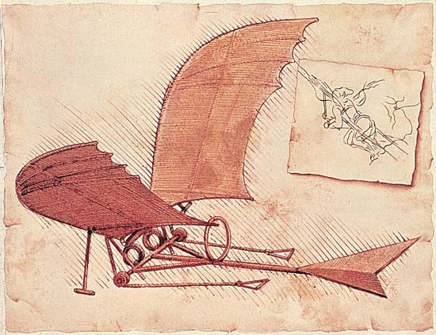
Da Vinci’s Workshop
Business psychologists dedicated to learning, innovation & change

Slide 2
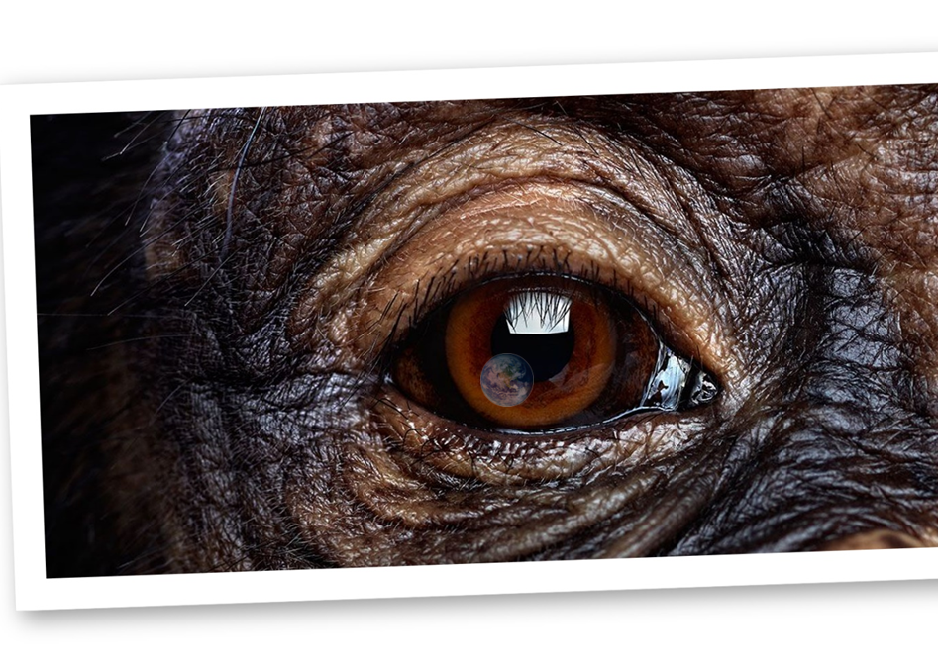
The psychology of attraction and repulsion in business
The Inner Ape

Slide 3
The psychology of attraction and repulsion in business
Psychology of perception
Psychology of communication and engagement
Introduction to Fast and Slow thinking (Or how we think and how we form judgements)
How to recognise other peoples styles and then adapt in order to build rapport and engagement

Slide 4
Psychology of perception
Daniel Kahneman’s “system 1 & 2”
- or “fast and slow thinking”
Notes:
Give example of brain as computer with apps running on it.
Apps are system 1 or fast thinking. User input is system 2 thinking or slow thinking.

Slide 5
4 simple examples to show how we think
Ball catch vs Maths
Stroop test
Observation test
Mind control game
Notes:
Ball catch exercise (system1) , followed by simple maths e.g. 2x4 (system1), 10x16 (systems 1 probably) followed by hard maths 16x 213 (system 2)

Slide 6
Maths problems that can make you tense
A bat and ball cost £1.10 when they were bought
Looking at the receipt I notice that the bat cost £1.00 more than the ball.
How much did the ball cost?

Slide 7
Why our brains prefer to be unconscious The Stroop test
System 1 & System 2 thinking in action
Notes:
Administer Stroop test, showing effort and effortless thinking processes. – system 1 and system 2

Slide 8
Red
Green
Black
Blue
Blue
Orange
Blue
Brown
Purple
Pink
Green
Grey
Brown
Grey
Black
Blue
Orange
Pink
Red
Blue
Red
Green
Black
Blue
Blue
Orange
Blue
Brown
Purple
Pink
Red
Green
Black
Blue
Blue
Orange
Blue
Brown
Purple
Pink
Notes:
This exercise helps delegates to experience the difference in effort when their conscious and unconscious thinking processes are being used.
Conclusion – Conscious thinking tales a lot more effort. So to save energy and time our brains have evolved to make as much thinking unconscious as possible.

Slide 9
Follow the instructions on screen…
Notes:
Count how many players wearing white pass the ball. Pause the video at 39seconds in. https://www.youtube.com/watch?v=IGQmdoK_ZfY&t=13s
This video demonstrates inattention blindness
inattention blindness is a fast thinking ‘app’. It’s a short cut or programme that filters out things we don’t need to pay attention to. It happens unconsciously.
Kahneman, Tsverski and Slovac showed we have many mechanisms like this running in our brain, These are automatic programmes that run and help us make sense of the world really easily (system 1 fast thinking). Some are pretty hardwired such as breathing or our fear response, but they get shaped by experience (still fear response). Some are learned behaviours or actions that then become automatic system 1 functions like catching a ball with a favoured hand.
When we do something deliberate with our conscious minds, we refer to it as system 2 slow thinking.

Slide 10
How many continuity changes are in this scene?
Notes:
Now lets see if your systems 2 conscious brain can over-rule your system 1 unconscious thinking ‘apps’ https://www.youtube.com/watch?v=ubNF9QNEQLA&t=7s
Test:
Note how many changes happen in this scene.
Ignore the story!
Your unconscious brain will want to pay attention to the story (the people) and ignore small changes in the scenery.
Explain the work of Pendry, Driscoll & Field (2007) showing how difficult it is to overcome Unconscious Biases

Slide 11
Mind control game
How would you go about raising that money?
Is it realistic?
Who would you like to raise it for?
How much would you/could you actually raise?
Notes:
Ask everyone to read the card under their chair.
You have been asked to raise $50dollars for a local charity
You have been asked to raise £50,000 for a local charity
Everyone notes down their answers on the cards.

Slide 12
Perception Conclusions
Our brains have two thinking systems working:
System 1 - Fast, automatic, intuitive, low energy (very efficient)
System 2 – Slow, deliberate, conscious, high energy cost (heavily influenced by system 1)

Slide 13
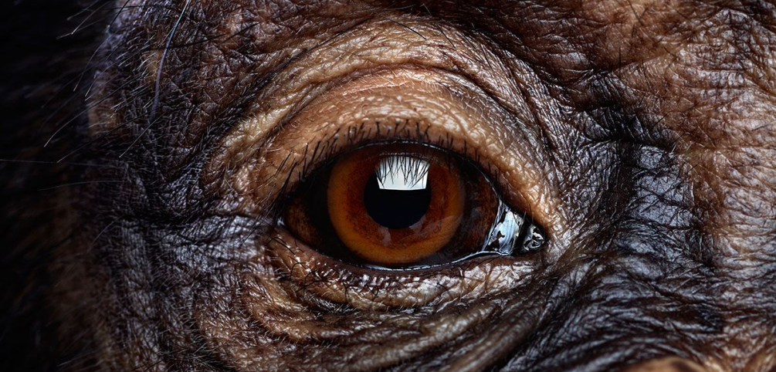
Psychology of communication and engagement
Inner ape – combined reflective tool
Notes:
Give example of brain as computer with apps running on it.
Apps are system 1 or fast thinking. User input is system 2 thinking or slow thinking.

Slide 14
How do you decide if you like someone?
Is this system 1 (fast and instinctive) or system 2 (slow and rational)
at work?
Values
Worldview,
politics and religion
Interests, social, job, etc.
First glance - physical and culture (my tribe or not)
Notes:
Rapport is a key element of stakeholder communication. Whether it is in the initial requirements capture stage or when you are reporting or managing scope creep, - how well you can talk to your stakeholders can change the outcome (and stress levels) of a project.
Explore the rapport triangle and how we normally make instant judgements on people. This is normal and every animal seems to need to make fast judgements for everyday survival based on basic information (such as sight, smell sound). These judgements are normally around friend or foe, food or predator etc.

Slide 15
What about once you get to know them?
First
glance
Interests, social,
job, etc.
Worldview, politics and religion
Values
Notes:
But real relationships are based on values and behaviours, - a lot more than just how we look or which demographic we are from. Common values become the foundation for rapport and relationship building.

Slide 16
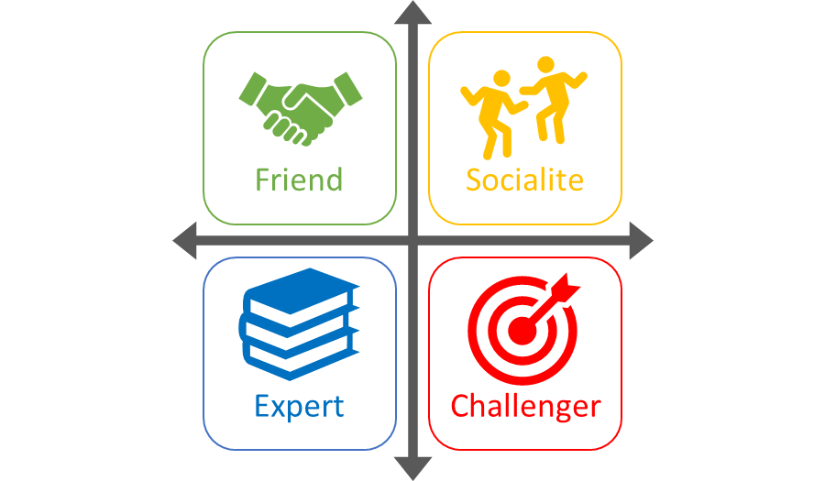
First
glance
Interests, social, job, etc.
Worldview,
politics and religion
Values
Notes:
So we are can be similar in some ways, different in others and our behaviour and responses can also be shaped by the situations and environment we find ourselves in.
The Inner Ape Combined Reflective Tool is a way to recognise some of those differences and ensure the difference is a positive thing (diversity) instead of a negative thing (style clashes). It is not a predictive tool. It is a framework or structure for understanding yourself and the people around you.
When we meet people who seem to have the same values, or way of looking at the world as us, we generally get on with them and build good rapport. When we meet people who seem to have very different values or world view to us, sometimes the relationship can be a little more … strained.
Often our values and world view, our very personality can be shown in the first few words that we speak. For example (say “hi, how are doing, its good to see you” in the 4 main style approaches. Note that you haven’t started to explain the styles yet and already delegates are able to identify which style you are roleplaying to them.
Over the next hour we will help you start to identify the style of someone that you are speaking to you so that you can adapt your own communication style to build greater rapport. We will also show you why you get on with some people and can become very frustrated with others. Although this workshop is about business situations, we will be very surprised if you don’t automatically start analysing family and friends, and some of the relationship dynamics there.
As we go through the descriptions it is worth noting that everyone has a bit of all of the styles (humans are complex and we are more than just one of 4 boxes!). However most of us have a preference for one or two styles and a dislike or intolerance of one of the styles. We can refer to these preferences as our ‘Prime Ape’ style.
This is where a tool such as the Inner Ape can be have great practical use. It helps us understand and the values and therefore motivations of ourselves and others, by observing communication style and behaviour. But before you can recognise others, you need to be aware of yourself…

Slide 17
Two traditional models for personality and communication
Jungian Models
Easy to use but not accurate
Lexicon Hypothesis
Difficult to use but very accurate
Inner Ape
Uses lexicon hypothesis but as easy as Jungian models

Slide 18
The 4 ‘Prime Ape’ styles
Notes:
Identify core values for each style.
being a good kind good person, being supportive to others
Being a fun person, bring energy and a smile to others
Being a smart person, self controlled, rational and analytical
Being an achiever, breaking barriers, overcoming challenges, being strong enough to take on anything
Whatever your values system, when you look in the mirror you want to see someone who lives and demonstrates those values. This has a big impact on our sense of self-worth and our happiness. Our values are linked to our sense of self-worth, and therefore it is our values which often drive our behaviours.
Your initial answers (from the last slide) will give you a good idea of which style you might affiliate most with.
Recap core values of each style before going deeper (next slides) for each style
Our next slides are about increasing that understanding, and also about being able to recognise, and then build rapport with others.

Slide 19
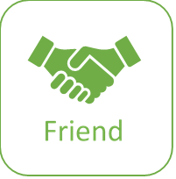
The Friendly Ape
Values
Dislikes
Communicates
When communicating with them…
Recognise them by…
Powered by www.DaVincisWorkshop.co.uk
Notes:
Explore key aspects for each style, including how to recognise them from their communication patterns, behaviours and focus. Ask delegates to identify the people in their life who demonstrate ‘Friendly’ as their Prime Ape preference.
Use ‘Trainer guide v7.2’ to assist you with the descriptions. Or refer to the ‘Inner Ape CRT Full doc v7.2’

Slide 20
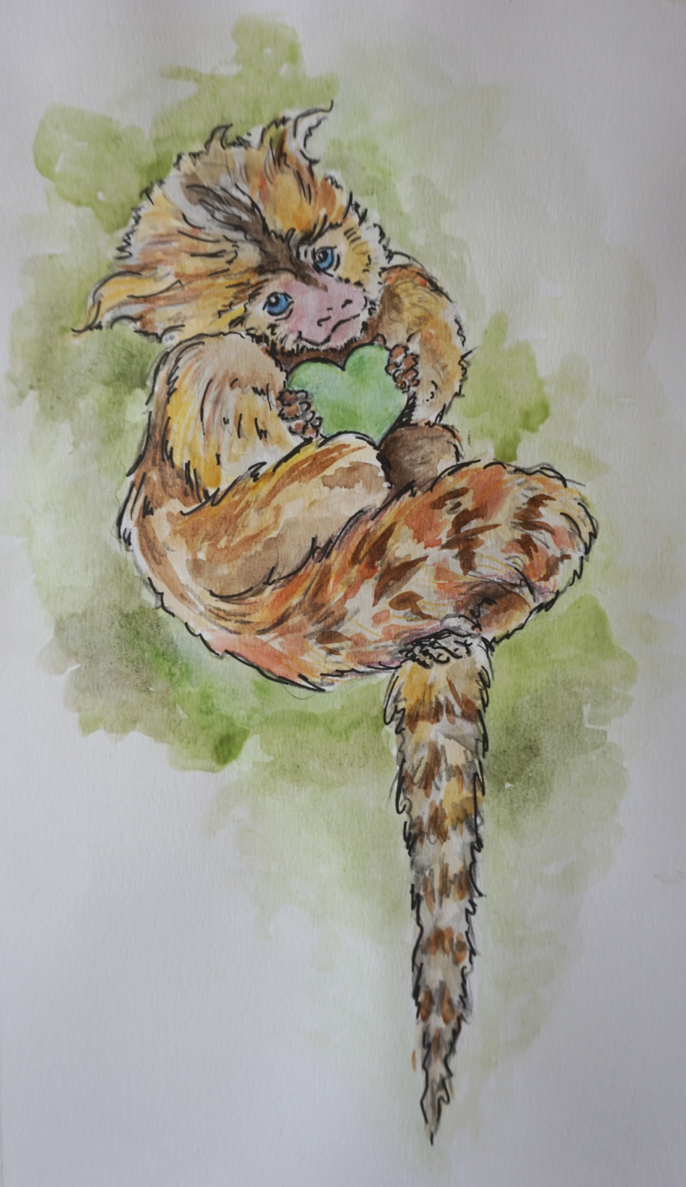
The Friendly Ape - Possibly the most important person in your life
Notes:
Present slogan and image to help embed idea of style

Slide 21
The Challenger Ape
Values
Dislikes
Communicates
When communicating with them…
Recognise them by…
Powered by www.DaVincisWorkshop.co.uk
Notes:
Explore key aspects for each style, including how to recognise them from their communication patterns, behaviours and focus. Ask delegates to identify the people in their life who demonstrate ‘Challenger’ as their Prime Ape preference.
Explore potential clash between Challenger and Friend using the ‘cross each other in a corridor’ situation example, asking:
What happens next?
How will they both feel after this interaction?
What advice would you give to the Challenger style, so they can build a better (more effective) relationship with the Friend style?
What advice would you give to the Friend style, so they can build a better (less stressful) relationship with the Challenger style?

Slide 22
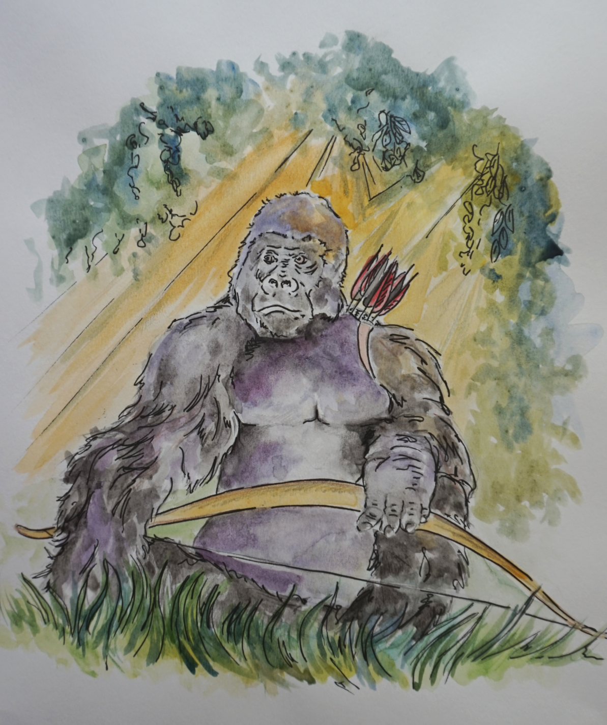
The Challenger Ape - Always looking for their next challenge / target
Notes:
Present slogan and image to help embed idea of style

Slide 23
The Expert Ape
Values
Dislikes
Communicates
When communicating with them…
Recognise them by…
Powered by www.DaVincisWorkshop.co.uk
Notes:
Explore key aspects for each style, including how to recognise them from their communication patterns, behaviours and focus. Ask delegates to identify the people in their life who demonstrate ‘Expert’ as their Prime Ape preference.

Slide 24
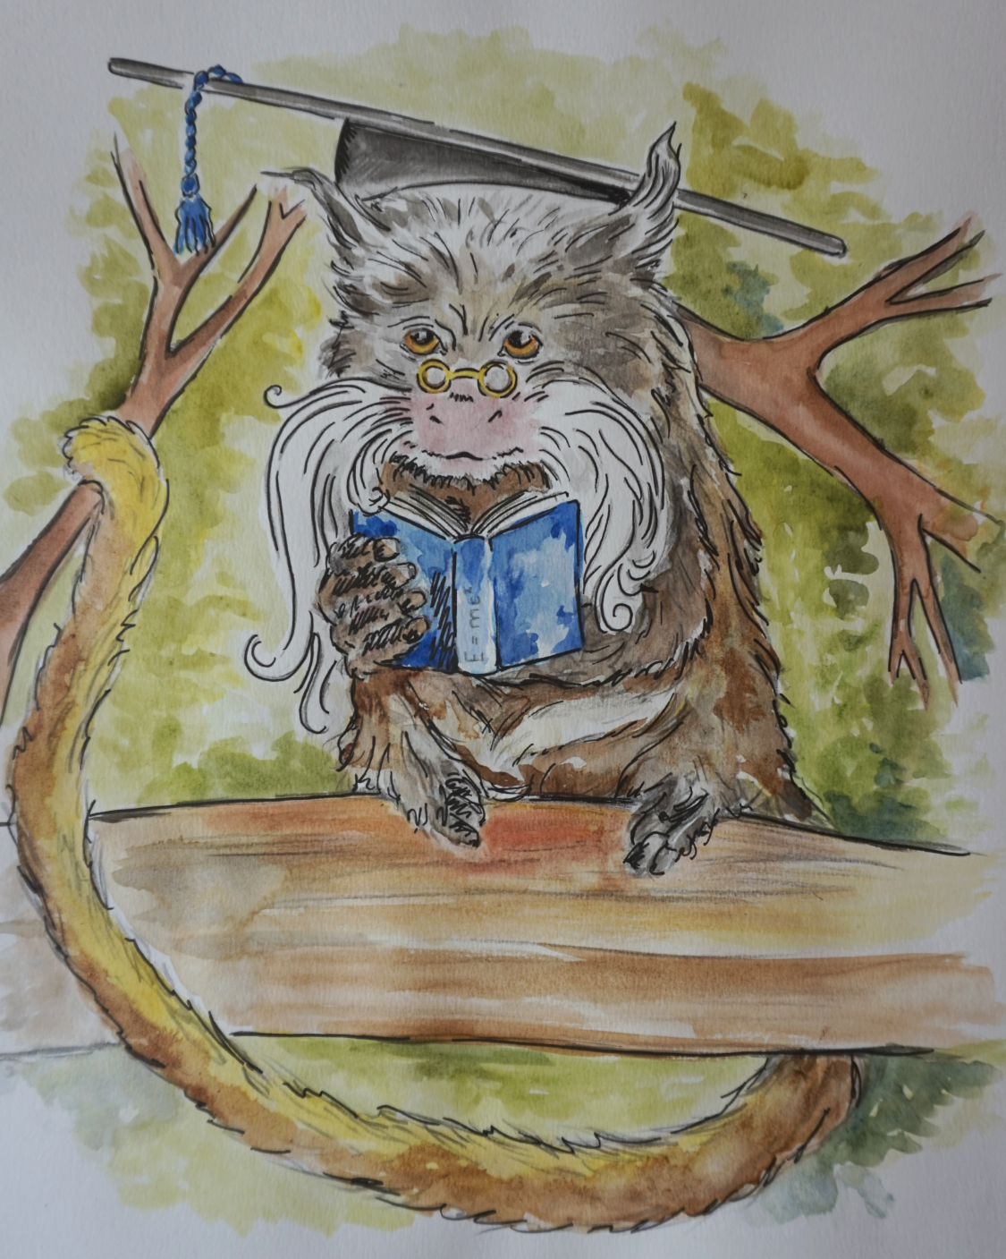
The Expert Ape - The perfect combination of knowledge and self-control
Notes:
Present slogan and image to help embed idea of style

Slide 25
The Social Ape
Values
Dislikes
Communicates
When communicating with them…
Recognise them by…
Powered by www.DaVincisWorkshop.co.uk
Notes:
Explore key aspects for each style, including how to recognise them from their communication patterns, behaviours and focus. Ask delegates to identify the people in their life who demonstrate ‘Socialite’ as their Prime Ape preference.
Explore potential clash between Socialite and Expert using the ‘cross each other in a corridor’ situation example, asking:
What happens next?
How will they both feel after this interaction?
What advice would you give to the Socialite style, so they can build a better (more relaxed) relationship with the Expert style?
What advice would you give to the Expert style, so they can build a better (more efficient) relationship with the Socialite style?

Slide 26
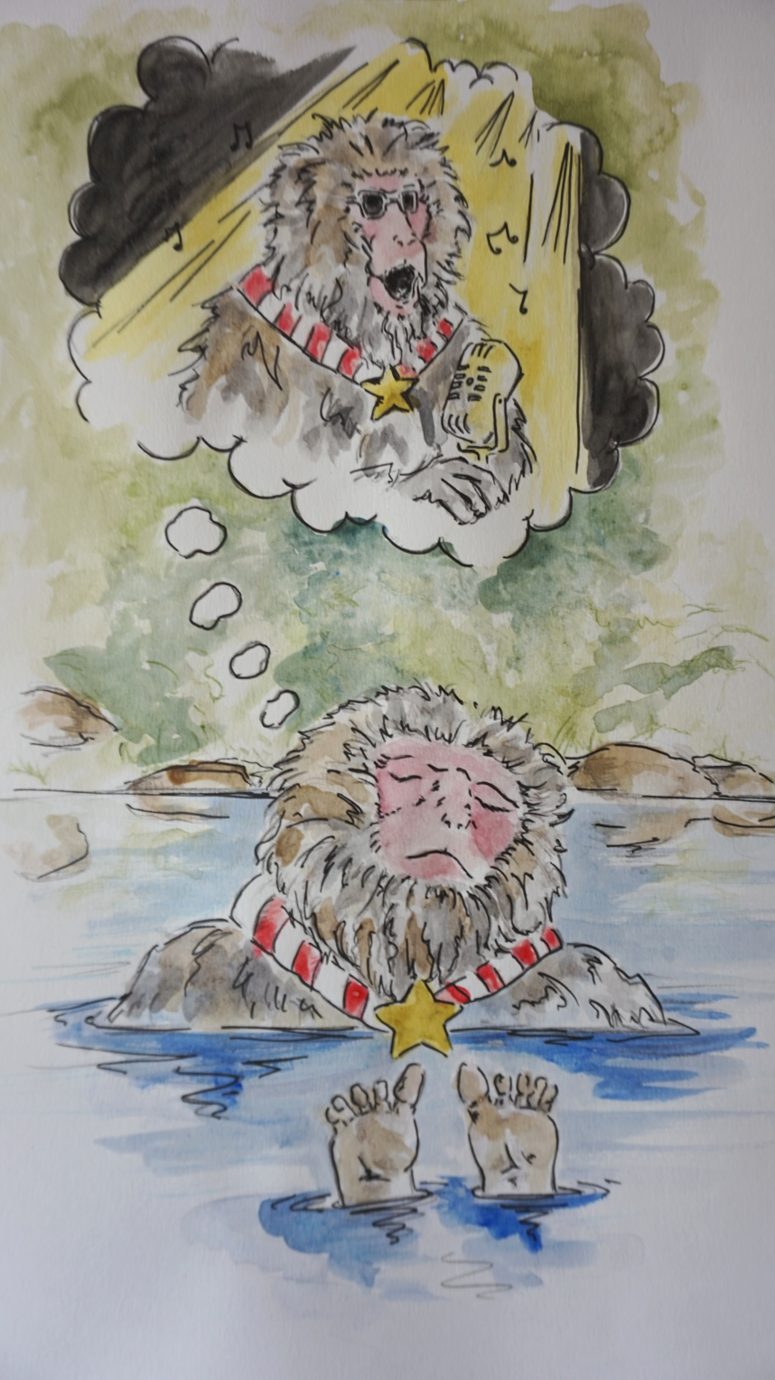
The Socialite Ape - Works hard, plays hard, looks good doing it!
Notes:
Present slogan and image to help embed idea of style

Slide 27
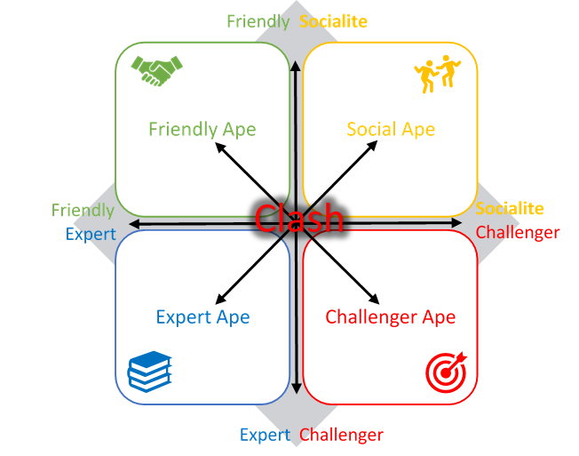
The main clashes
Notes:
Review the main clash points
These can be easily avoided simply by moderating our behaviour and how we communicate.
You don’t need to radically change or be fake. You can still be yourself, just a slightly adapted and enhanced version of yourself, that can therefore handle the situation you find yourself in, a bit more easily and perhaps a bit more successfully!

Slide 28
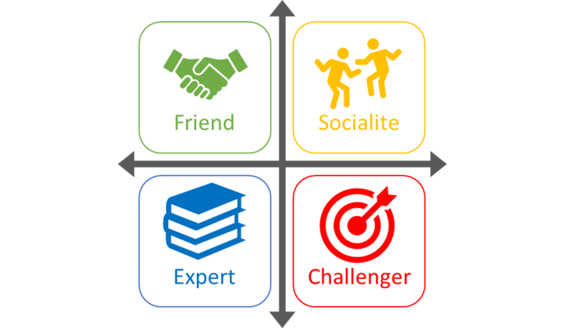
Think about the people you find it harder to communicate, connect and engage with.
What do you suspect their prime ape preference to be?
So how should you communicate with them, if you want to improve your relationship and make life easier for both of you?
Notes:
Exercise:
(follow the instructions on the slide)

Slide 29
Inner Ape conclusion for attraction and repulsion
Adaption is the key to success:
“Speak to people how you would like to be spoken to.”
“You should speak to people how THEY would like to be spoken to.”
Powered by www.DaVincisWorkshop.co.uk
Notes:
Adaption is the key to success.
Many of you would have heard this common wisdom
“Speak to people how you would like to be spoken to.”
Its about respect isn’t it.
Unfortunately it is very wrong. It assumes that your communication style is the correct one and it is not respectful, or even considerate of someone else’s preferences. So instead it should be…
… Because that is what builds rapport and engagement

Slide 30
Additional slides, resources and exercises available at… www.davincisworkshop.co.uk
The Inner Ape

Slide 31
How well do you know your key stakeholders?
Stakeholder | Inner Ape preference | Preferred communication channel | Level of contact | Motivators
David Jones | Challenger / Expert Strong focus on performance, direct, time poor. Be concise but accurate. | Face to face summary with supporting information where appropriate. | Engage at the start of the project and then via a direct report . Engage if/when deadlines slip or when scope is expected to change. | Interested in impact on bottom line results. Interested in continuous improvement and innovation.
….
….
Powered by www.DaVincisWorkshop.co.uk
Notes:
Exercise.
Create a stakeholder communications map, listing not just who your stakeholders are, but also their: Inner Ape style, preferred communication channel, level of contact and known business motivators. This can be used in conjunction with a power/interest grid to analyse key stakeholders and the correct way to engage/manage them
Ask everyone to review their stakeholder Map, or review each others if they are aware of each others stakeholders.

Slide 32
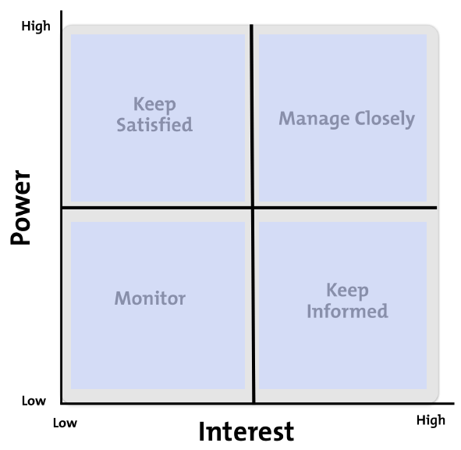
Who are your key stakeholders?
“Treating all stakeholders equally is a recipe for disaster.”
Taking your role, write down who your key stakeholders are, they may be your team, your peers, managers above you or a project team…
Plot them into the Power/Interest Map.
Powered by www.DaVincisWorkshop.co.uk
Notes:
Do you agree with this statement?
Why?
It is important to know how your key stakeholders are likely to act when you take decisions within your teams, departments, projects. You will need to agree the best way to engage with them and communicate with them to achieve the best results.

Slide 33
What are your biggest challenges?
“Treating all stakeholders equally is a recipe for disaster.”
Exercise
Write down the two biggest stakeholder/client challenges that you currently face
2. Create a full communication map (slide 30) for them including their Inner Ape style
Powered by www.DaVincisWorkshop.co.uk

Slide 34
Additional tools … Mapping the Inner Ape to other frameworks…
Powered by www.DaVincisWorkshop.co.uk

Slide 35
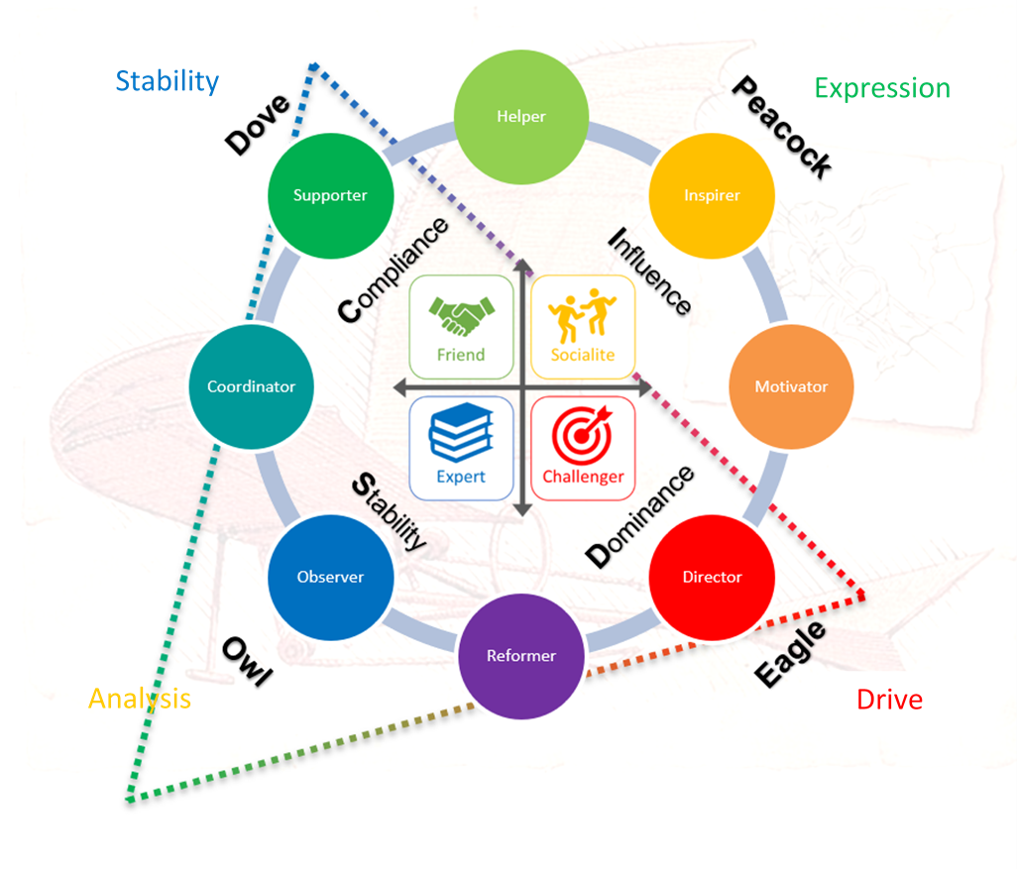
The Inner Ape mapped to: DiSC, Insights, Birds Behavioural Styles, SDI and Prism

Slide 36
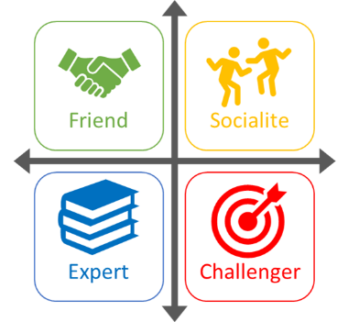
The inner Ape mapped to Tetramap and Japanese Blood Types
AB
B
Water (Calm)
Fire (Bright)
A
O
Air (Clear)
Earth (Firm)
Powered by www.DaVincisWorkshop.co.uk

Slide 37
The inner Ape mapped to MBTI (where possible)
MBTI (Jung’s 8 psychological types) | Translates to the Inner Ape as…
Extraverted sensation | Challenger
Introverted sensation | Expert
Extraverted intuition | Socialite
Introverted intuition | Friend
Extraverted thinking | Challenger
Introverted thinking | Expert
Extraverted feeling | Socialite
Introverted feeling | Friend

Slide 38
Da Vinci’s Workshop
Business psychologists dedicated to learning, innovation & change
Follow our series of 12 cutting edge business psychology articles on linked-in. Helping to celebrate 500 years of Da Vinci’s Legacy

